Slide 1
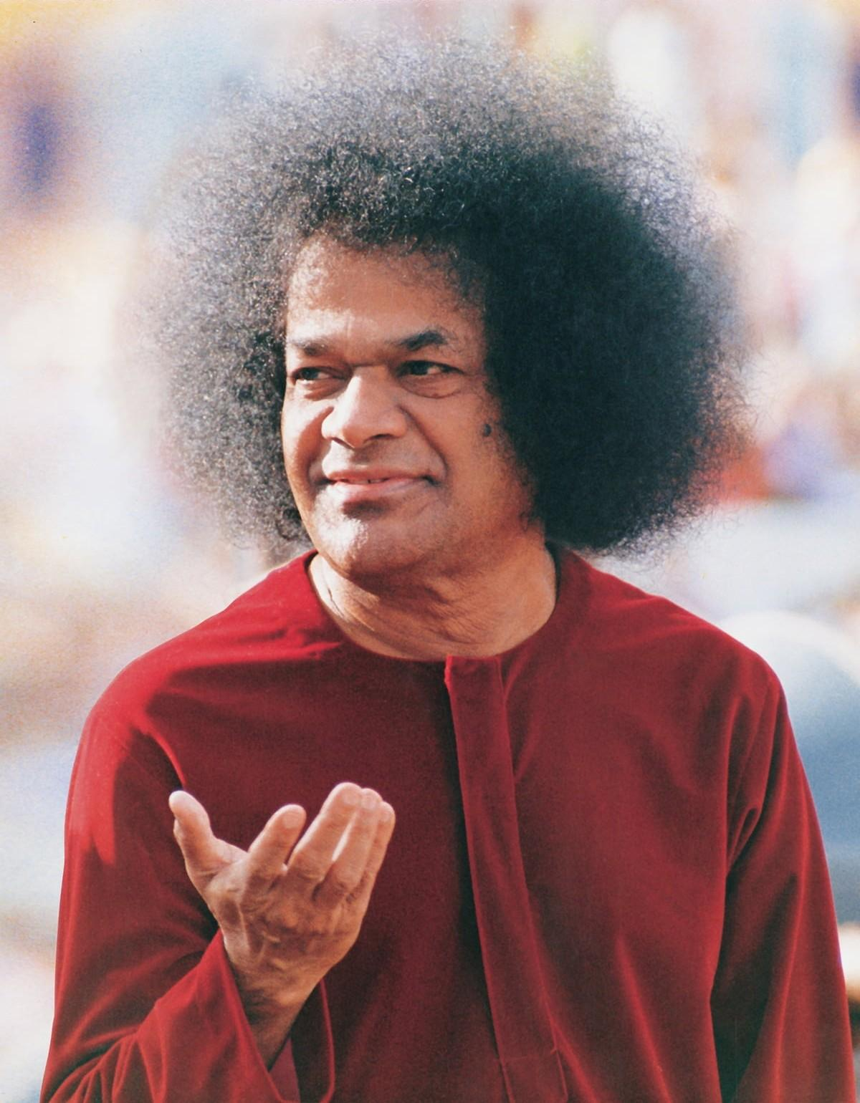
An Offering at Thy Lotus Feet

Slide 2
Feedback Form Generation
Presenting by,
G. Sai Shravan, K.Maruthi Prasad

Slide 3
About Project
This project is to build a web application which helps the teachers to give the feedback to the students and issue the feedback forms to the students by printing them.The application should also has the feature to upload data of the students details and fetch the students data from the database when giving the feedback.
The overall objective of this project is to reduce the work load on the teachers and save their prime time.

Slide 4
Framework & Technology Used :
backend -Django
Python - language
Html,CSS,Bootstrap

Slide 5

Django Framework :
Django is a high-level python web framework that encourages rapid development and clean, pragmatic design.It takes care of much of the hassle of web development.
Django follows the MVT design pattern (Model View Template).
Model - The data you want to present, usually data from a database.
View - A request handler that returns the relevant template and content - based on the request from the user.
Template - A text file (like an HTML file) containing the layout of the web page, with logic on how to display the data.
Some of the popular websites or apps powered by Django are: Mozilla, Spotify, Udemy, Coursera, Youtube, NASA, and many more.

Slide 6
Modules :
Giving feedback by Warden
Uploading Data into the database
User Registration& User Login
Giving feedback
by Faculty

Slide 7

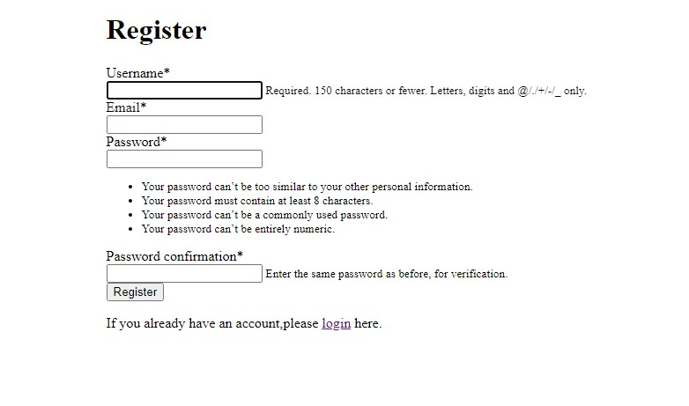
User Registration :
Django-registration is an extensible application providing user registration functionality for Django-powered Websites.
Although nearly all aspects of the registration process are customizable, out-of-the-box support is provided for two common use cases:
Two-phase registration, consisting of initial signup followed by a confirmation email with instructions for activating the new account.
One-phase registration, where a user signs up and is immediately active and logged in.

Slide 8
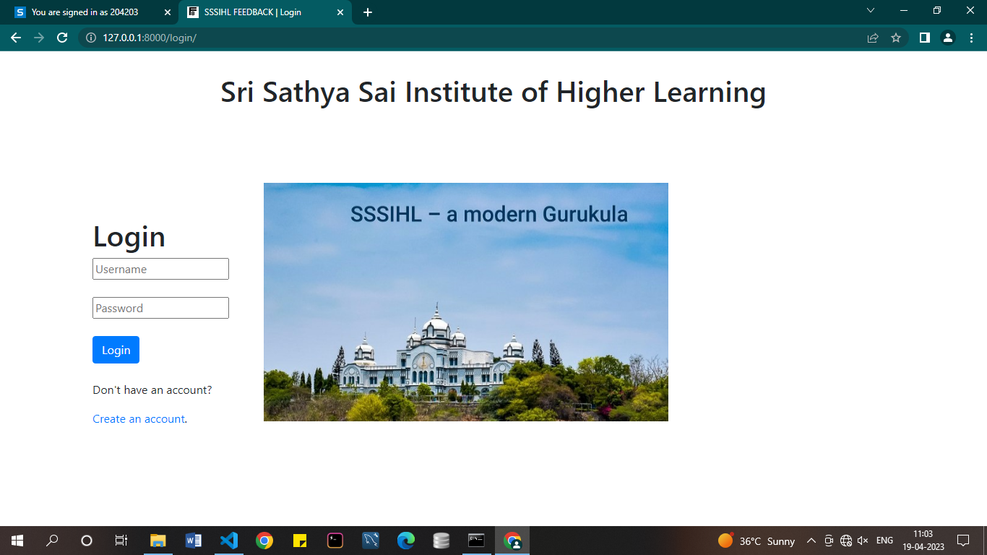
User Login :
Django comes with an inbuilt authentication system.The Django authentication system handles both authentication and authorization.
Briefly, authentication verifies a user is who they claim to be, and authorization determines what an authenticated user is allowed to do.
When the user tries to login log in, the django authentication system checks whether the user is registered or not. If yes, the user can log in.

Slide 9
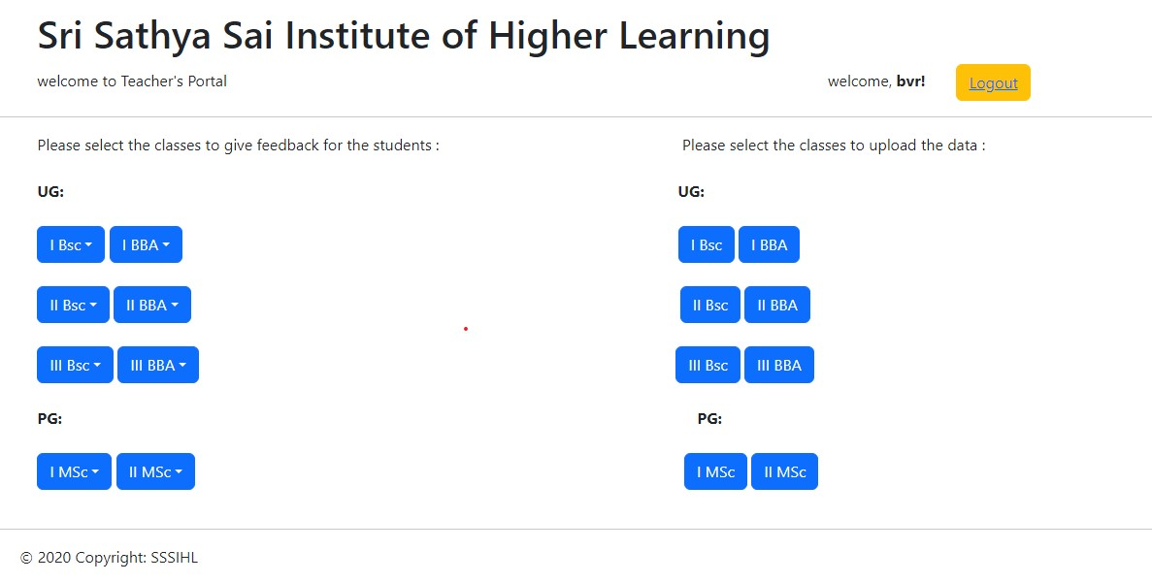
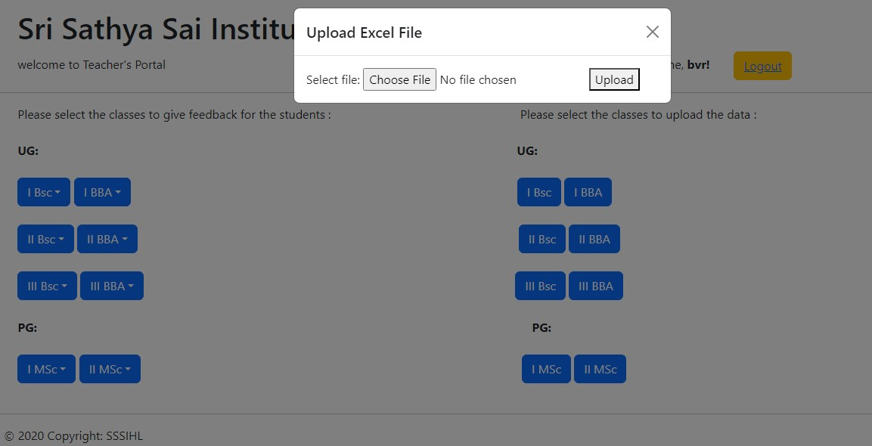
Homepage :
When the user logins he has two choices, one is to give feedback and the other is to upload data of the students.
When User wants to upload the student details the modal popups and asks the user to select the excel file and upload.
When user uploads th excel file it gets saved to it’s particular database table.

Slide 10
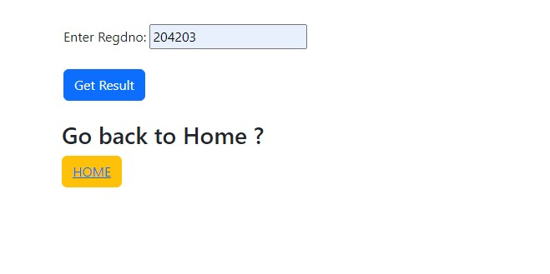
Giving Feedback :
When the user chooses to give the feedback, he gets the list option of the semesters to select semester to give the feedback on students.
Then user gets the page asking Regdno for the input, when the user enters the Regdno and clicks the submit the data of that student is fetched from the database and the details of that student is kept on the form .

Slide 11
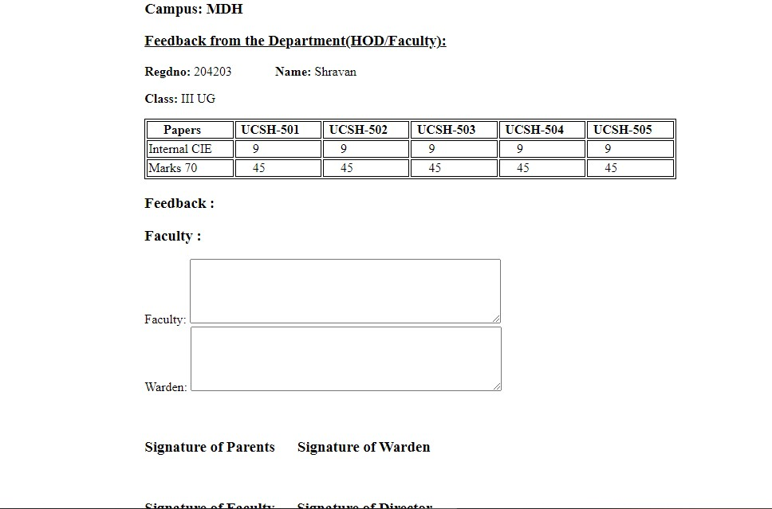
Feedback Form :
when the teacher enters the Regdno and clicks on submit button, the above feedback form comes on to the page with that particular student details of that particular semester with his Regdno, Name, Class, and marks of that semester including internal CIE and overall marks for 70.
Then the teacher has two textboxes where he can give the feeback to that particular student.
When the teacher submits the form to the database, only the data in the two text boxes given will be saved to the database at the student table of that particular student.

Slide 12
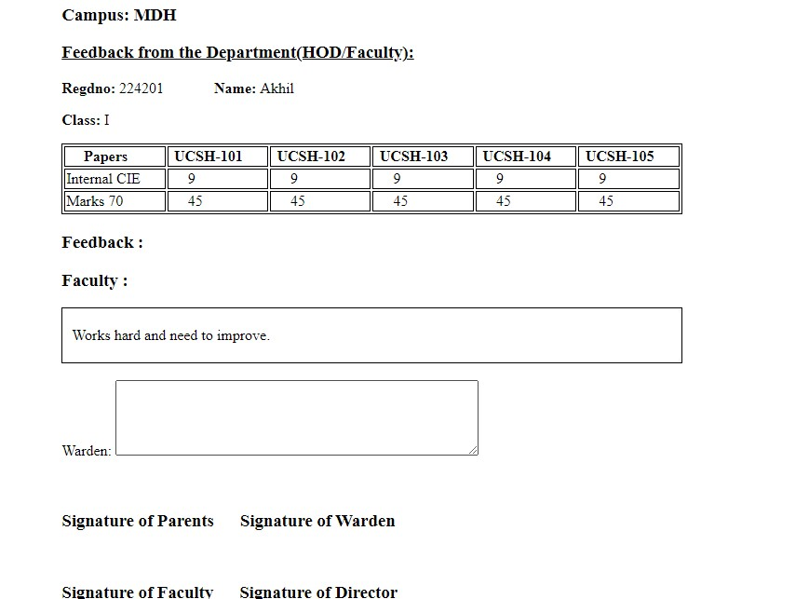
Feedback by warden:
When the Faculty gives the feedback and submits the data given will be saved to database. Then warden plays a role in giving feedback to all the students, when the warden selects the class and provide Regdno and clicks submit, the feedback form with all the details including Faculty feedback is fetched into the form. Based on that warden gives the feedback to the students.

Slide 13
Project highlights
User Friendly
User can easily use this application without any problems.
Saves Time
Our project helps the teachers to save their time without entering much of student details manually.

Slide 14
Our Project Guide :
we would like to extend our sincere thanks to Sri.B.Venkata Ramana sir for his supportive, thoughtful and caring guidance, for this project would not be what it is without him.
Thank You JAI SAI RAM.

